Slide 1

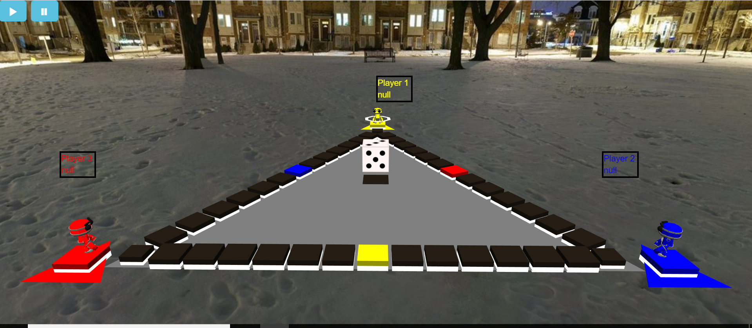
TRUDO

Slide 2

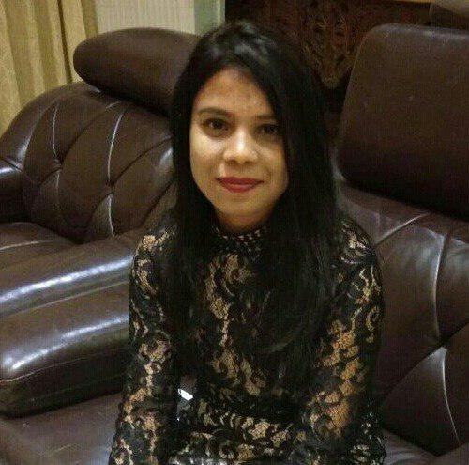
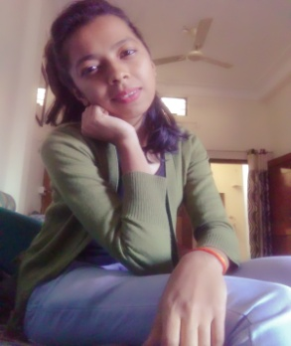
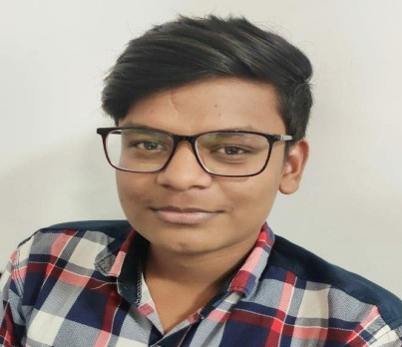
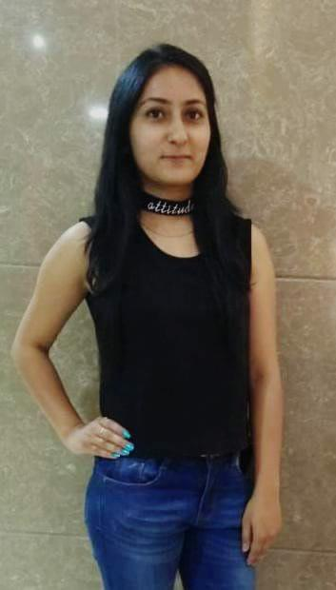
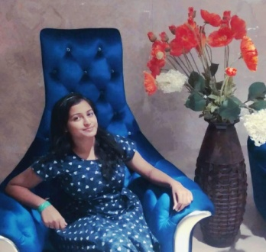
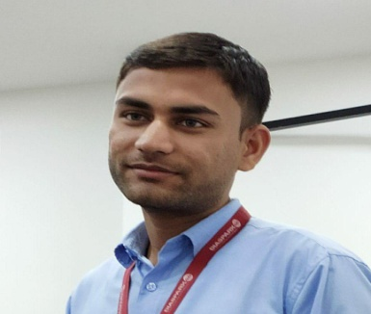
TEAM INTRODUCTION
ANKITA TRIPATHI
Team Lead
SHREYA DESAI HARSHIT MOURYA GARIMA MANALI SETHI NILESH VERMA
KHANDELWAL

Slide 3
Problem Statement
VISION:
Vision for developing TRUDO is to provide some more engagement methods in our traditional games and gaming system and to give a 3D view to the conventional LUDO game with some different look and feel.
CHALLENGES:
→3D triangular board
→3D dice
→3D player view

Slide 4
WORK DISTRIBUTION
Role Of Each Member
Shreya Desai
And
Harshit Mourya
1.Front End
2.Deployement
3.Documentation
4.Skybox
jio
M
Manali Sethi
And
Nilesh Verma
1.Functioning
Ankita Tripathi
And
Garima Khandelwal
1.UI of Game
2.Integration

Slide 5
WORK HOURS
PROJECT ASSIGNED:
12 july 2019
TIME GIVEN:
2 weeks
TIME GIVEN TO EACH MODULE: Total hours-130hours
Analysis and requirement gathering
15 hours
Creating 3D live trudo scene
20 hours
Functioning
45 hours
Integration and Hosting
20 hours
Extra Work
30hours

Slide 6
WORK STATUS
Work Completed
UI of the game is completed.
3D Trudo Plane is completed
Functioning and coloring of avatar is done.
Responsive
Winner of game is declared at the last.
Name is assigned to each player.
Step by step moving of player is done.
What not has completed
Timer
A team has only one player, so they will automatically step up when dice will rol

Slide 7
Q & A

Slide 8
Thank You!!

